Slide 1

McGraw-Hill Technology Education
Copyright © 2006 by The McGraw-Hill Companies, Inc. All rights reserved.

Slide 2
Chapter 5A
Transforming Data Into Information

Slide 3
How Computers Represent Data
Number systems
  A manner of counting
  Several different number systems exist
Decimal number system
  Used by humans to count
  Contains ten distinct digits
  Digits combine to make larger numbers

Slide 4
How Computers Represent Data
Binary number system
  Used by computers to count
  Two distinct digits, 0 and 1
  0 and 1 combine to make numbers
Notes:
Teaching Tip
Table 5A.1 on page 187 provides the first 17 binary numbers and their decimal equivalent. A fun exercise is to teach the students to count in binary on their fingers.

Slide 5
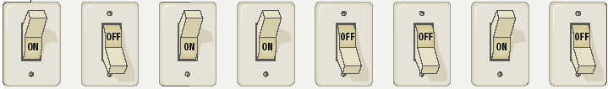
How Computers Represent Data
Bits and bytes
  Binary numbers are made of bits
  Bit represents a switch
  A byte is 8 bits
  Byte represents one character

Slide 6
How Computers Represent Data
Text codes
  Converts letters into binary
  Standard codes necessary for data transfer
  ASCII
    American English symbols
  Extended ASCII
    Graphics and other symbols
  Unicode
    All languages on the planet
Notes:
Insider information
Windows XP, Mac OS X and newer flavors of Linux are fully Unicode compatible.

Slide 7
How Computers Process Data
The CPU
  Central Processing Unit
  Brain of the computer
  Control unit
    Controls resources in computer
    Instruction set
  Arithmetic logic unit
    Simple math operations
    Registers
Notes:
Teaching tip
Table 5A.4 on page 190 lists the operations handled by the common ALU.

Slide 8
How Computers Process Data
Machine cycles
  Steps by CPU to process data
  Instruction cycle
    CPU gets the instruction
  Execution cycle
    CPU performs the instruction
  Billions of cycles per second
  Pipelining processes more data
  Multitasking allows multiple instructions
Notes:
Insider information
More pipelines mean a faster and more efficient CPU. The current fastest CPU on the market, the Apple G5 has 80 pipelines!

Slide 9
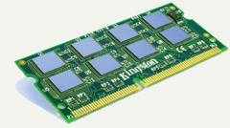
How Computers Process Data
Memory
  Stores open programs and data
  Small chips on the motherboard
  More memory makes a computer faster

Slide 10
How Computers Process Data
Nonvolatile memory
  Holds data when power is off
  Read Only Memory (ROM)
  Basic Input Output System (BIOS)
  Power On Self Test (POST)
Notes:
Teaching tip
If you are in a computer lab, spend a few minutes exploring your BIOS. Demonstrate what happens when values are adjusted. Walk through a POST check. Unplug a device and generate POST errors. Be sure to reset everything before moving on with the lecture!

Slide 11
How Computers Process Data
Flash memory
  Data is stored using physical switches
  Special form of nonvolatile memory
  Camera cards, USB key chains

Slide 12
How Computers Process Data
Volatile memory
  Requires power to hold data
  Random Access Memory (RAM)
  Data in RAM has an address
  CPU reads data using the address
  CPU can read any address
Notes:
Teaching tip
One of the most commonly asked questions is “How do I speed up my computer”. The simplest answer is to add RAM. The Productivity Tip on page 200 provides some guidelines when to add RAM.

Slide 13
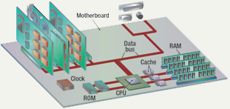
Components affecting Speed

Slide 14
Affecting Processing Speed
Registers
  Number of bits processor can handle
  Word size
  Larger indicates more powerful computer
  Increase by purchasing new CPU

Slide 15
Affecting Processing Speed
Virtual RAM
  Computer is out of actual RAM
  File that emulates RAM
  Computer swaps data to virtual RAM
    Least recently used data is moved

Slide 16
Affecting Processing Speed
The computer’s internal clock
  Quartz crystal
  Every tick causes a cycle
  Speeds measured in Hertz (Hz)
    Modern machines use Giga Hertz (GHz)
Notes:
Teaching tip
Spend a little time here discussing over clocking. Over clocking causes the computer to run faster than designed. Possibly, you have students that can share stories of over clocking.

Slide 17
Affecting Processing Speed
The bus
  Electronic pathway between components
  Expansion bus connects to peripherals
  System bus connects CPU and RAM
  Bus width is measured in bits
  Speed is tied to the clock

Slide 18
Affecting Processing Speed
External bus standards
  Industry Standard Architecture (ISA)
  Local bus
  Peripheral control interface
  Accelerated graphics port
  Universal serial bus
  IEEE 1394 (FireWire)
  PC Card

Slide 19
Affecting Processing Speed
Peripheral control interface (PCI)
  Connects modems and sound cards
  Found in most modern computers

Slide 20
Affecting Processing Speed
Accelerated Graphics Port (AGP)
  Connects video card to motherboard
  Extremely fast bus
  Found in all modern computers

Slide 21
Affecting Processing Speed
Universal Serial Bus (USB)
  Connects external devices
  Hot swappable
  Allows up to 127 devices
  Cameras, printers, and scanners

Slide 22
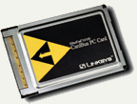
Affecting Processing Speed
PC Card
  Used on laptops
  Hot swappable
  Devices are the size of a credit card

Slide 23
Affecting Processing Speed
Cache memory
  Very fast memory
  Holds common or recently used data
  Speeds up computer processing
  Most computers have several caches
  L1 holds recently used data
  L2 holds upcoming data
  L3 holds possible upcoming data

Slide 24
Chapter 5A
End of Chapter

